Slide 1
Info 2602 web and tech 1
Joshua oxley – 816009424
Kenaird saunders – 816008473
Adrian santo - 816008774

Slide 2
Problem: Information over-load
Solution: We decided to focus on the topic of Efficiency as our target solution. We intend to achieve this by implementing a “Login” and a “Search” function. With the Login function, users would be able to log into the app and have the videos from the previous search displayed. The search function would accept a search value from the user which will filter through Youtube’s API and display the top 10 results.
Though we intended to fully implement these ideas and functions, we were unable to properly insert it as we ran into various issues when we were coding and as such, the features were not fully implemented.

Slide 3
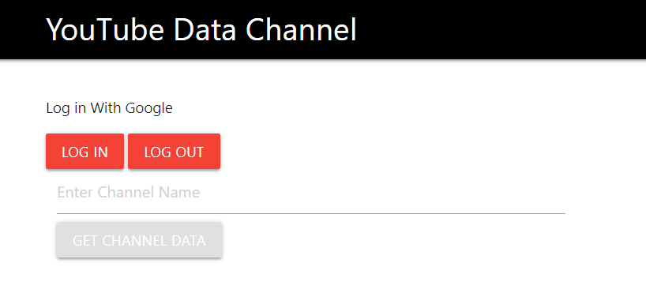
Home Page:

